Slide 1
Spam Detector
By- Raj Sharma

Slide 2
INTRODUCTION
Context
The SMS Spam Collection is a set of SMS tagged messages that have been collected for SMS Spam research. It contains one set of SMS messages in English of 5,574 messages, tagged according being ham (legitimate) or spam.
What is a Spam Filtering?
Spam Detector is used to detect unwanted, malicious and virus infected texts and helps to separate them from the nonspam texts. It uses a binary type of classification containing the labels such as ‘ham’ (nonspam) and spam. Application of this can be seen in Google Mail (GMAIL) where it segregates the spam emails in order to prevent them from getting into the user’s inbox.

Slide 3
INTRODUCTION
A collection of 5573 rows SMS spam messages was manually extracted from the Grumbletext Web site. This is a UK forum in which cell phone users make public claims about SMS spam messages, most of them without reporting the very spam message received. The identification of the text of spam messages in the claims is a very hard and time-consuming task, and it involved carefully scanning hundreds of web pages.
A subset of 3,375 SMS randomly chosen ham messages of the NUS SMS Corpus (NSC), which is a dataset of about 10,000 legitimate messages collected for research at the Department of Computer Science at the National University of Singapore. The messages largely originate from Singaporeans and mostly from students attending the University. These messages were collected from volunteers who were made aware that their contributions were going to be made publicly available.

Slide 4
PROBLEM STATEMENT
: It is a supervised machine learning algorithm where words probabilities play the main rule here. If some words occur often in spam but not in ham, then this incoming e-mail is probably spam. Naïve bayes classifier technique has become a very popular method in mail filtering software. Bayesian filter should be trained to work effectively. Every word has certain probability of occurring in spam or ham email in its database. If the total of words probabilities exceeds a certain limit, the filter will mark the e-mail to either category.

Slide 5
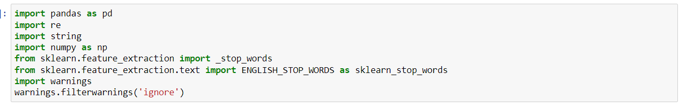
Text Mining Library used
Machine Learning model building Library used

Slide 6
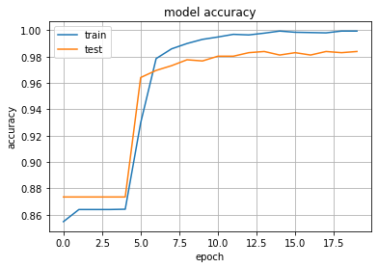
Model Accuracy

Slide 7
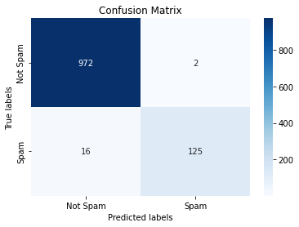
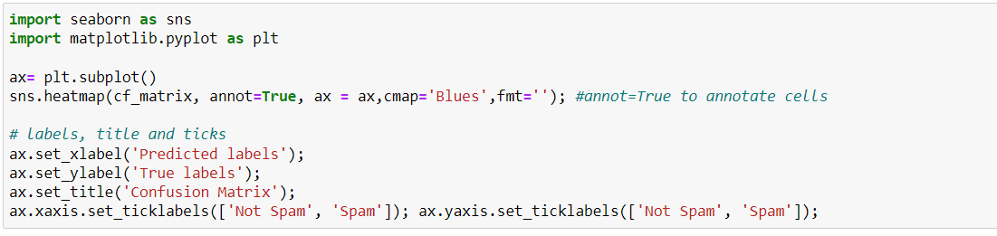
Confusion matrix

